Slide 1

Item 14: Declare Functions noexcept If They Won’t Emit Exceptions.
Scott Meyers - Effective Modern C++
Presented By
@7eRoM

Slide 2
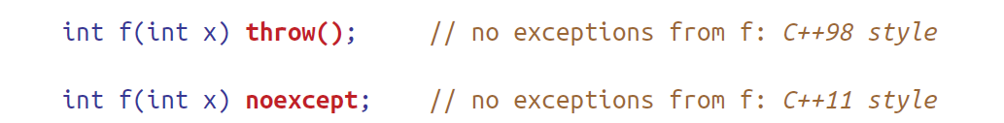
In C++11, unconditional noexcept is for functions that guarantee they won’t emit exceptions.
Permits compilers to generate better object code.
Consider a function f that promises callers they’ll never receive an exception:
If, at runtime, an exception leaves f, f’s exception specification is violated.
The stack unwinding is a process where the function call stack entries are removed at runtime. To remove stack elements, we can use exceptions. If an exception is thrown from the inner function, then all of the entries of the stack is removed, and return to the main invoker function.

Slide 3
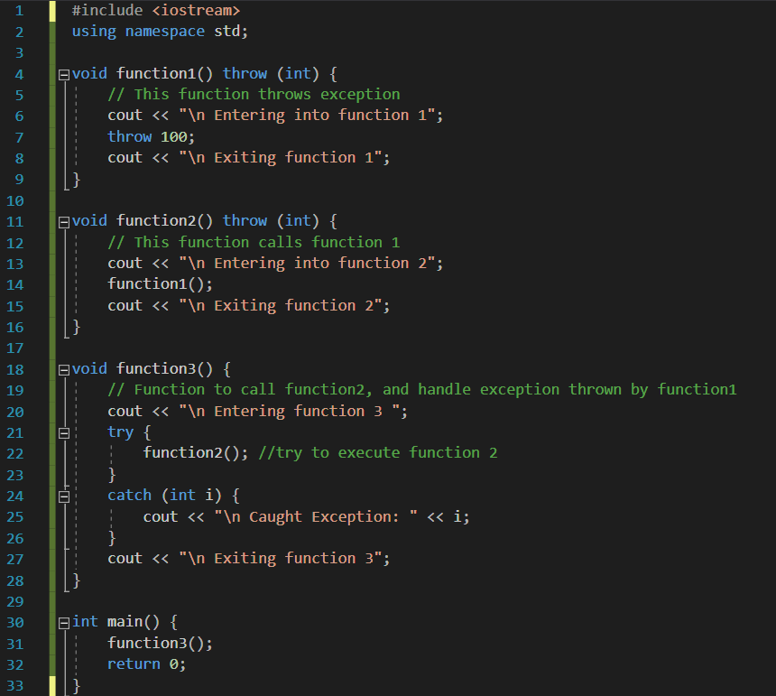
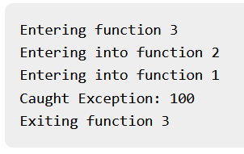

Slide 4
With the C++98 exception specification:
The call stack is unwound to f’s caller, and
After some actions not relevant here, program execution is terminated.
With the C++11 exception specification:
The stack is only possibly unwound
Program execution is terminated.
The difference between unwinding the call stack and possibly unwinding it has a surprisingly large impact on code generation. In a noexcept function,
optimizers need not keep the runtime stack in an unwindable state if an exception would propagate out of the function,
optimizers need not ensure that objects in a noexcept function are destroyed in the inverse order of construction should an exception leave the function.

Slide 5
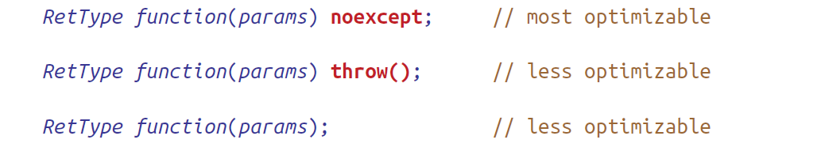

Slide 6
No-throw guarantee (failure transparency): Operations are guaranteed to succeed and satisfy all requirements even in exceptional situations. If an exception occurs, it will be handled internally and not observed by clients.
Strong exception safety (commit or rollback semantics): Operations can fail, but failed operations are guaranteed to have no side effects, leaving the original values intact.
Basic exception safety: Partial execution of failed operations can result in side effects, but all invariants are preserved. Any stored data will contain valid values which may differ from the original values. Resource leaks (including memory leaks) are commonly ruled out by an invariant stating that all resources are accounted for and managed.
No exception safety: No guarantees are made.
Classifications of Exception Safety

Slide 7
Consider a std::vector, when an item x is added to a vector v if the existing capacity isn't sufficient.
No-throw guarantee: Implemented by ensuring that memory allocation never fails, or by defining the insert function's behavior on allocation failure (for example, by having the function return a boolean result indicating whether the insertion took place).
Strong exception safety: Implemented by doing any necessary allocation first, and then swapping buffers if no errors are encountered (the copy-and-swap idiom). In this case, either the insertion of x into v succeeds, or v remains unchanged despite the allocation failure.
Basic exception safety: Implemented by ensuring that the count field is guaranteed to reflect the final size of v. For example, if an error is encountered, the insert function might completely deallocate v and reset its count field to zero. On failure, no resources are leaked, but v's old value is not preserved.
No exception safety: An insertion failure might lead to corrupted content in v, an incorrect value in the count field, or a resource leak.

Slide 8
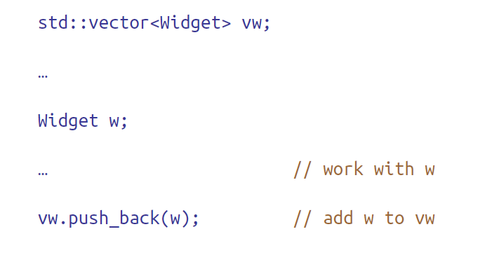
In case of
Size == capacity
In C++98, the transfer was accomplished by copying each element from the old memory to the new memory, then destroying the objects in the old memory. (strong exception safety guarantee)
In C++11,
a natural optimization would be to replace the copying of elements with moves.
because the behavior of legacy code could depend on push_back’s strong exception safety guarantee. Therefore, C++11 implementations can’t silently replace copy operations inside push_back with moves unless it’s known that the move operations won’t emit exceptions.
“move if you can, but copy if you must” strategy

Slide 9
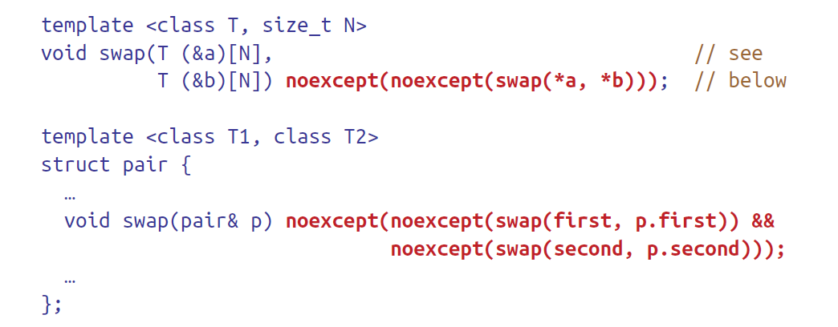
How can a function know if a move operation won’t produce an exception?
If the operation is declared noexcept
These functions are conditionally noexcept

Slide 10
Most functions are exception-neutral:
throw no exceptions themselves, but functions they call might emit one.
allows the emitted exception to pass through on its way to a handler further up the call chain
are never noexcept, because they may emit such “just passing through” exceptions
When you can honestly say that a function should never emit exceptions, you should definitely declare it noexcept
But twisting a function’s implementation to permit a noexcept declaration is bad practice:
Complicate code at callee )e.g., catching all exceptions and replacing them with status codes or special return values(
Complicate code at caller (e.g. checking for status codes or special return values)
The runtime cost of those complications (e.g., extra branches, larger functions that put more pressure on instruction caches)

Slide 11
Memory deallocation functions (i.e., operator delete and operator delete[]) and Destructors:
in C++98, it was considered bad style to permit to emit exceptions
in C++11, this style rule has been all but upgraded to a language rule
no need to declare them noexcept
the only time a destructor is not implicitly noexcept is when a data member of the class (including inherited members and those contained inside other data members) is of a type that expressly states that its destructor may emit exceptions (e.g., declares it “noexcept(false)”)
such destructors are uncommon and there are none in the Standard Library

Slide 12
Wide Contract functions have well-defined behavior for all possible inputs. In other words, A function with a wide contract has no preconditions. Such a function may be called regardless of the state of the program, and it imposes no constraints on the arguments that callers pass it. Functions with wide contracts never exhibit undefined behavior.
Narrow Contracts mean that the functions can only be called when certain preconditions are met. For such functions, if a precondition is violated, results are undefined.
Some examples:
std::vector<int>’s .size() member function has a wide contract because it can be called on any instance of a vector
The operator[](size_t index) (as in int x = v[10]) has a narrow contract, because it can only be called with a parameter that is less than .size(), otherwise it is undefined.
The .at(size_t i) member function (as in int y = v.at(10)) however has a wide contract, because it is specified to throw an exception when the index is out of range.

Slide 13
Wide Contracts:
If you’re writing a function with a wide contract and you know it won’t emit exceptions, declare It noexcept
Narrow Contracts:
suppose you’re writing a function f taking a std::string parameter, and suppose f’s natural implementation never yields an exception. That suggests that f should be declared noexcept.
suppose that f has a precondition: the length of its std::string parameter doesn’t exceed 32 characters. declaring f noexcept seems appropriate ☺
Note: f is under no obligation (but could be useful e.g., during system testing) to check this precondition, because functions may assume that their preconditions are satisfied. (Callers are responsible for ensuring that such assumptions are valid.)

Slide 14
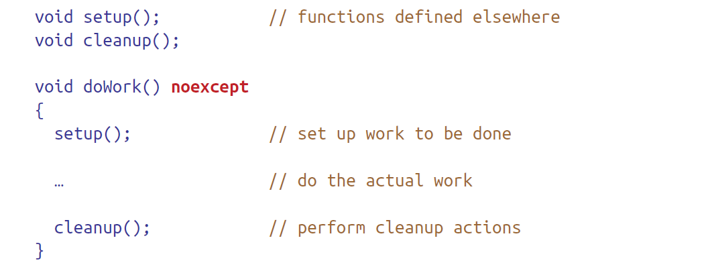
Compilers typically offer no help in identifying inconsistencies between function implementations and their exception specifications.
It could be that setup and cleanup document that they never emit exceptions, even though they’re not declared that way.
There could be good reasons for their non-noexcept declarations. For example, they might be part of a library written in C Or they could be part of a C++98 library that decided not to use C++98 exception specifications and hasn’t yet been revised for C++11.
Because there are legitimate reasons for noexcept functions to rely on code lacking the noexcept guarantee, C++ permits such code, and compilers generally don’t issue warnings about it.

Slide 15

This item was quite challenging!
☺

Slide 16
Ref.
https://www.tutorialspoint.com/stack-unwinding-in-cplusplus
https://en.wikipedia.org/wiki/Exception_safety
https://stackoverflow.com/questions/51292673/what-is-in-simple-understanding-narrow-contract-and-wide-contract-in-terms-of

